Slide 1
End point assessment
Infrastructure Technician

Slide 3
EPA – Gateway preparation
Make sure all your examination certificates are uploaded to ecordia (by Feb 8th)
Submit evidence for all outstanding criteria on ecordia (by Feb 8th)
Review and accept all feedback on evidence submitted to ecordia (by Feb 8th)
Ensure your weekly log is up to date (by Feb 8th)
Book time with your team leader or manager to assist them in completing the forms on pages 54-74 of the Digital Industries Apprenticeship: Standard Specific Guidance for Training Providers – Infrastructure
Complete the Infrastructure Technician competencies evidence checklist on pages 75-91 of the Digital Industries Apprenticeship: Standard Specific Guidance for Training Providers – Infrastructure Technician
Submit the completed forms from items 5 and 6 no later than Feb 15
Choose a project no later than February 15th

Slide 4
Current status to date
495 Infrastructure Technician EPAs completed
808 total EPAs completed
220 Distinctions
36 Merits
483 Passes
69 Fails (get feedback on why, can go through the resit – same process all over again)
91% success rate

Slide 6
Portfolio
No two portfolios are the same
There is no template
In addition to the evidence I suggest:
What is your job
Where do you work
What are the systems
What skills do you need/have/developed
What have you learnt during the apprenticeship
What are you NOW responsible for
Who have you worked with and how have they helped you
Notes:
Open your text editor and build this page.

Slide 7
Portfolio
Submit your best work
If you submit 1 good piece and 3 poor pieces, the assessor will assume you are usually poor
Notes:
Open your text editor and build this page.

Slide 8
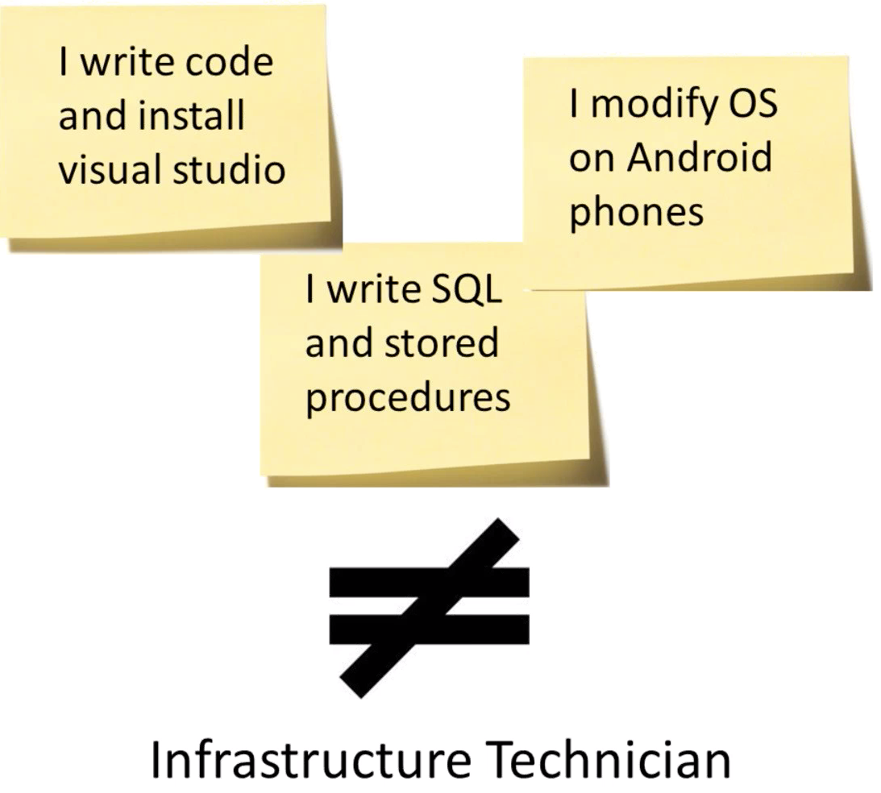
Portfolio
Make sure the work applies to the right standard
Notes:
Open your text editor and build this page.

Slide 9
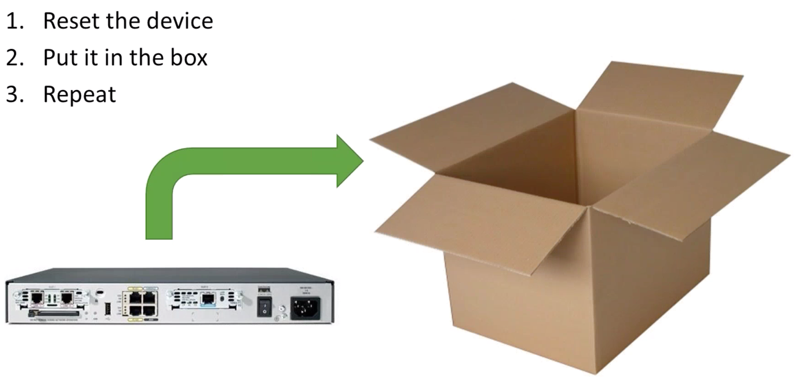
Portfolio - problem
Too little evidence
Notes:
Open your text editor and build this page.

Slide 10
Portfolio - problem
Too little evidence – tools
Need to provide evidence of using 9 tools in total:
3 for testing
3 for troubleshooting
3 for analysing
Notes:
Open your text editor and build this page.

Slide 11
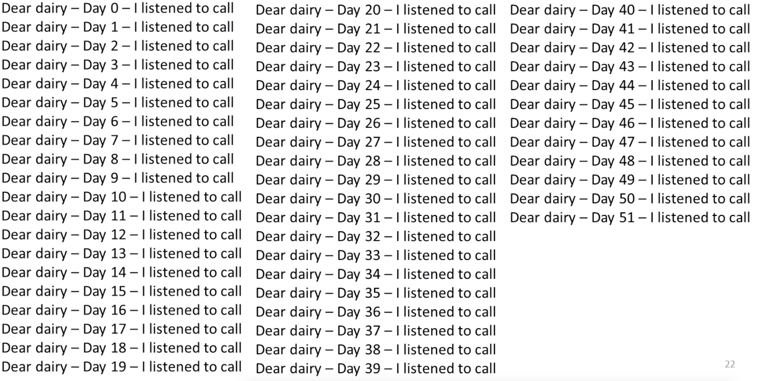
Portfolio - problem
Too much evidence
Notes:
Open your text editor and build this page.

Slide 12
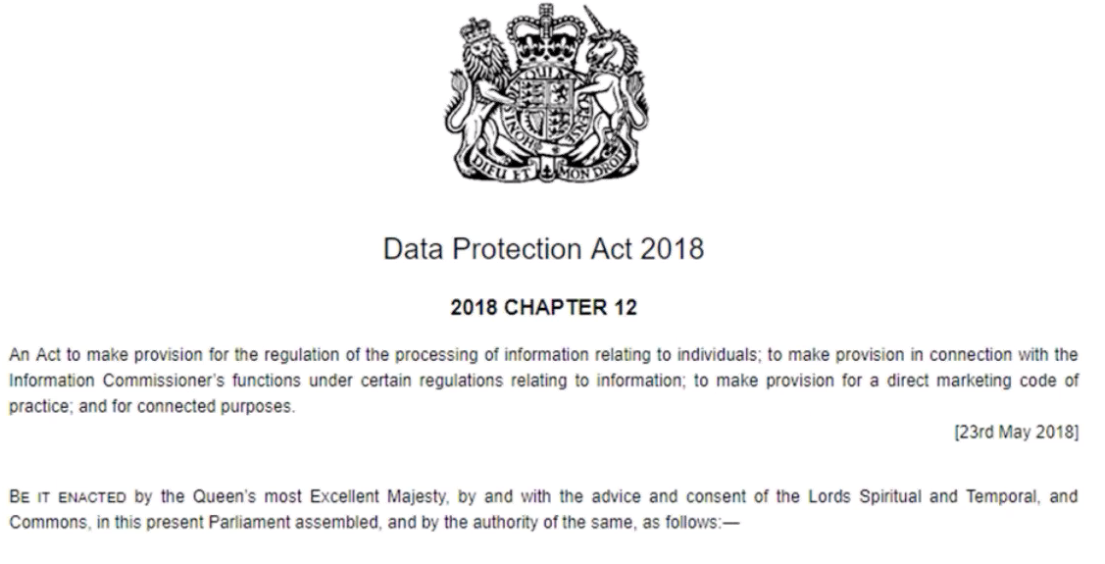
Portfolio - problem
Knowledge – not competence
Did you write the act, or do you act upon it?
Notes:
Open your text editor and build this page.

Slide 13
Portfolio - problem
Omitting vital evidence
First question in interview – What do you do in your job?
Does your portfolio contain evidence of what you do in your job?
Notes:
Open your text editor and build this page.

Slide 14
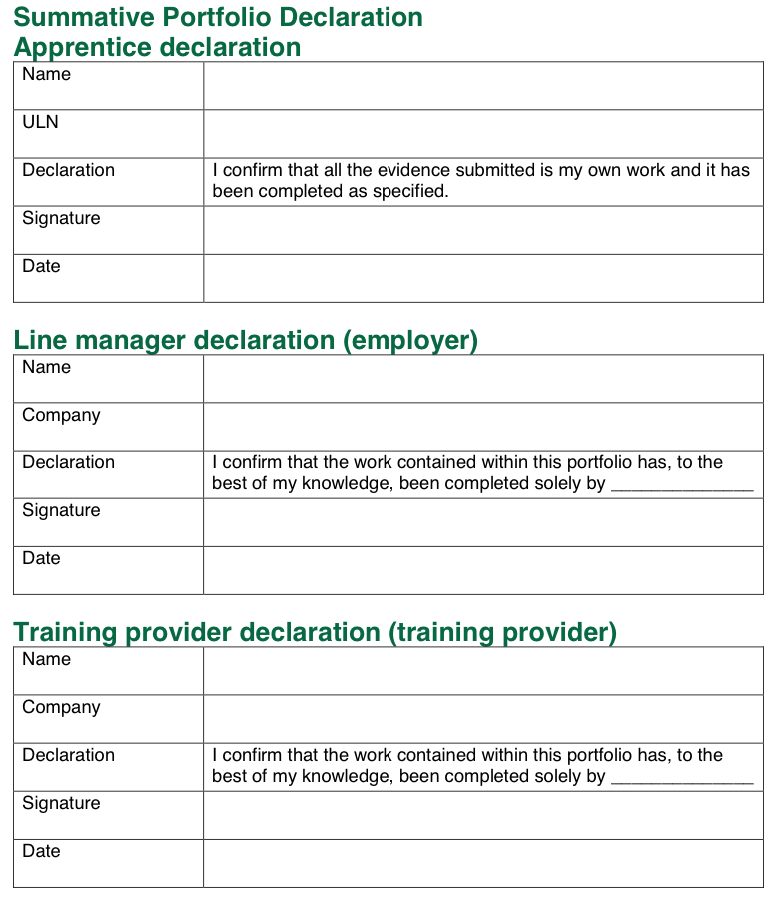
Portfolio
Notes:
Open your text editor and build this page.

Slide 15
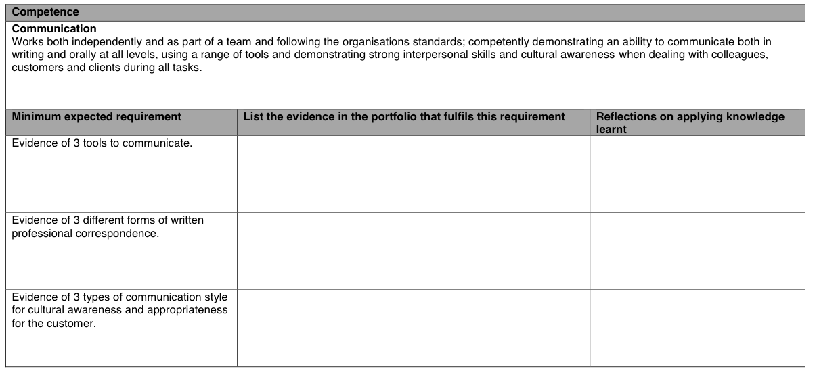
Portfolio – template 5
Notes:
Open your text editor and build this page.

